Slide 1

Data Analysis
project
Attention Deficit Hyperactivity Disorder(ADHD)
Taqwa Abd Alghani
18.11.2025
taqwa.ab1990@gmail.com

Slide 2

Data Selection
&
General Overview
https://www.kaggle.com/datasets/a7md19/adhd-dataset-4-classes-u2?select=adhd_data.csv
Attention Deficit Hyperactivity Disorder (ADHD)
-A common neurological disorder that affects the behavior of children and adults .
-Types: Inattention - Hyperactivity – Impulsivity .
-Diagnostic process :
1- Comprehensive assessment
2- Clinical observation Information gathering
3- Personal and family history
-No cure for ADHD

Slide 3
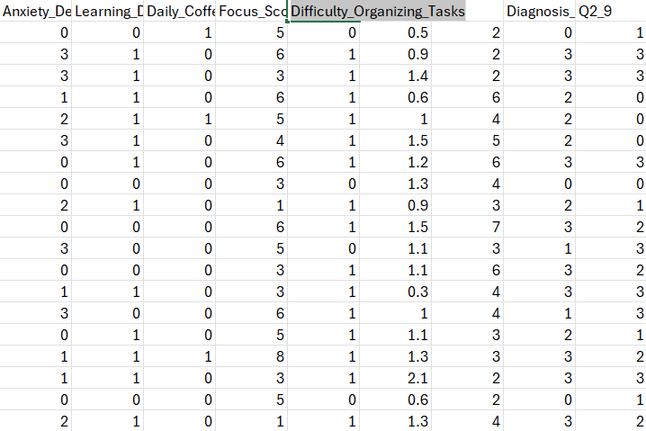
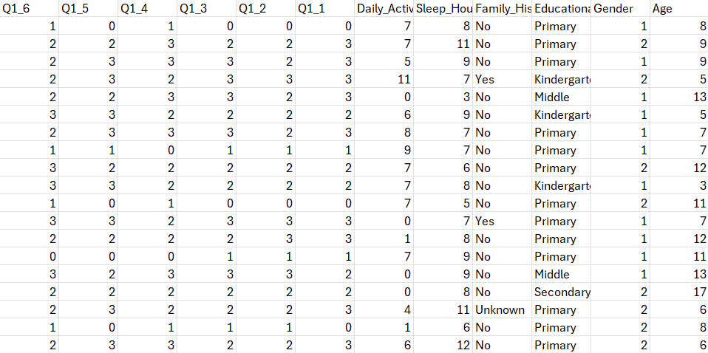
Excel Table
(6500 rows × 32 columns)

Slide 4
Let’s Define The Features
Age
Gender: (1-male \ 2-female )
Educational Level: ( Kindergarten \ Primary \ Middle \ Secondary \ University \ Working \ Not Working )
Family History: ( Yes \ No \ Unknown )
Sleep Hours Per Day
Daily Activity Hours
Q1.1-9 (self Questionnaire)
Q2.1-9 (observable Questionnaire)
Diagnosis Class (0-3): “No ADHD \ Inattentive type \ Hyperactive-Impulsive type \ Combined type “
Daily Phone Usage Hours
Daily Walking Running Hours
Difficulty Organizing Tasks (0-1): “No\Yes”
Focus Score Video (0-10) Daily Coffee Tea Consumption
Learning Difficulties (0-1): “No\Yes”
Anxiety Depression Levels (0-3): “No Anxiety-Depression \ mild \ moderate \ severe”

Slide 5
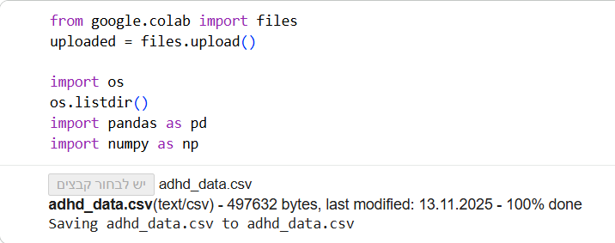
Entering Data Into Python

Slide 6
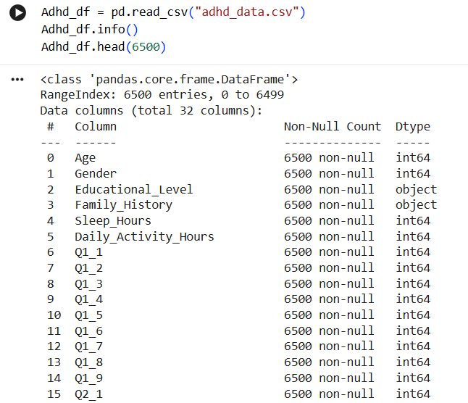
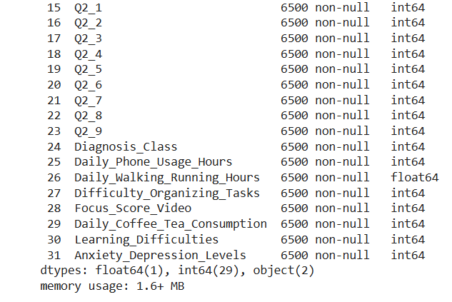

Slide 7
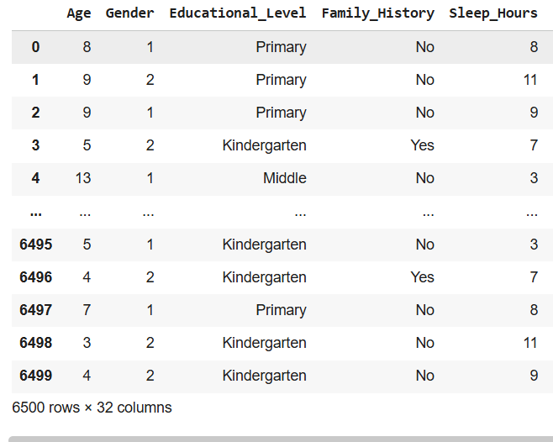
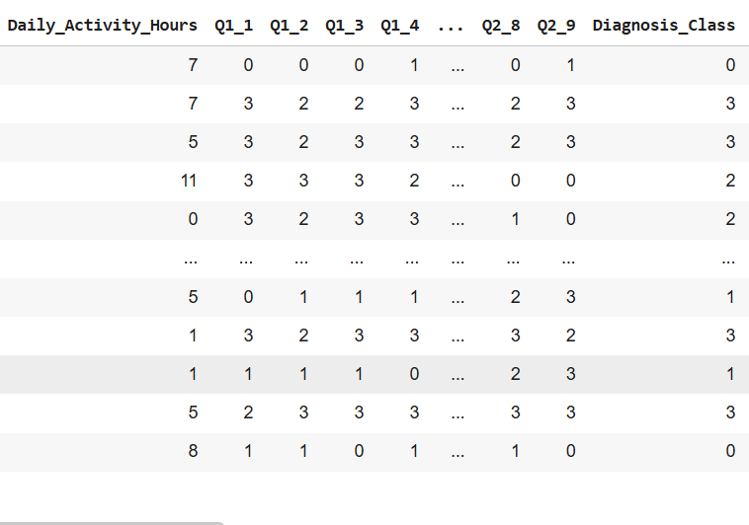

Slide 8
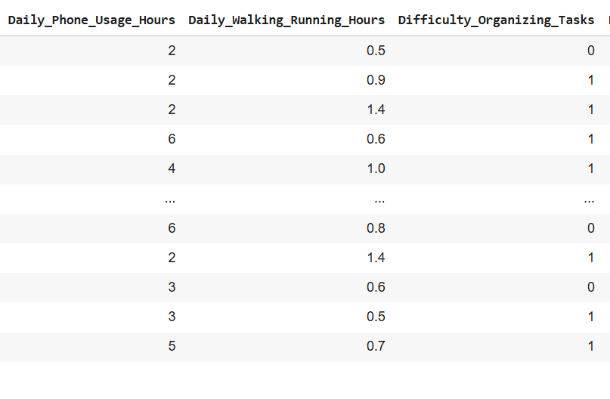
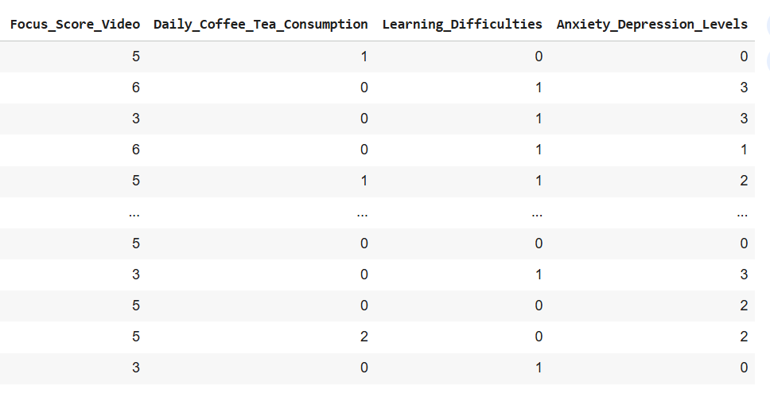

Slide 9

Define Your Research
Questions
General Profile :
1) Distribution of Age
Population Differences :
2) Distribution of Sleep Hours by Gender
3) Anxiety severity × Daily Activity Hours
ADHD Diagnosis :
4) Distribution of ADHD Diagnosis Classes
5) Focus Score by Diagnosis Class
Family & Background :
6) Family History × Diagnosis Class
Psychological & Behavioral Relationships:
7) diagnosed with the 3 subtypes × Learning Difficulties
8) diagnosed with the 3 subtypes × Organizing Tasks Difficulties
Self vs Observable Assessment :
9) Relationship between Q1_avg and Q2_avg

Slide 10

Data Cleaning & Preprocessing

Slide 11
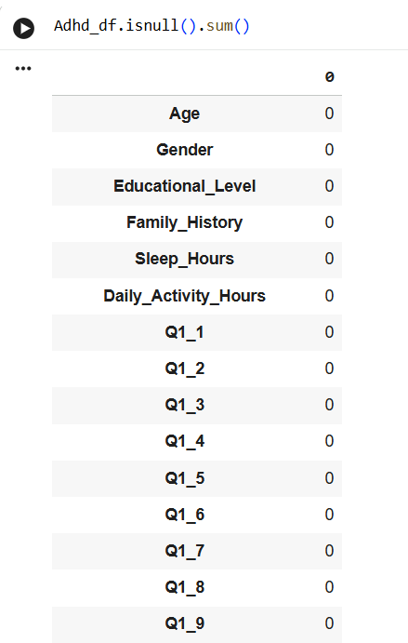
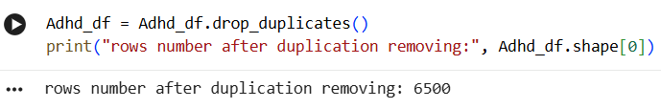
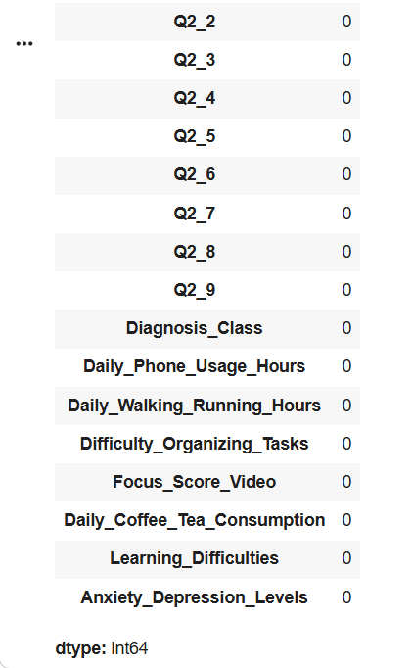
Null Values & Duplications

Slide 12
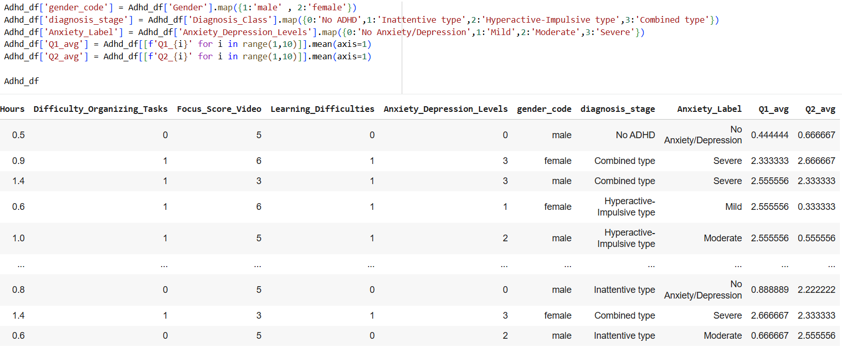
Adding New Features

Slide 13
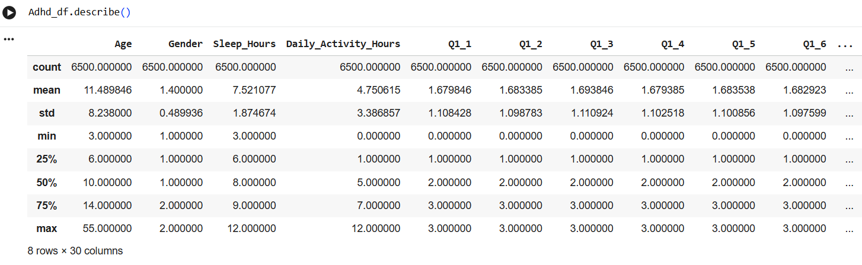
Descriptive Statistics

Slide 14

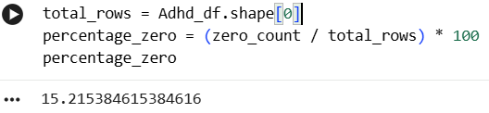
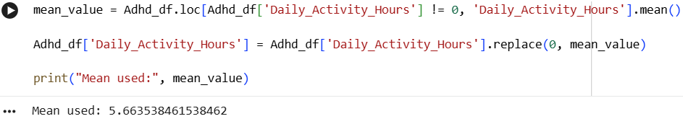
Zero Value !

Slide 15
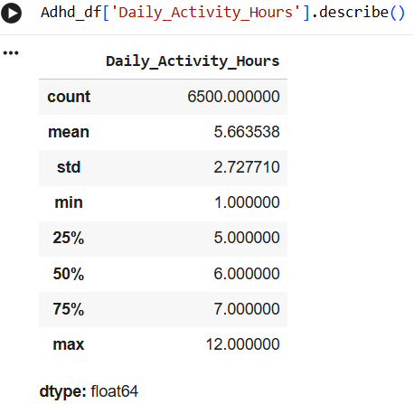
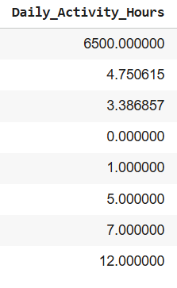
Continue

Slide 16
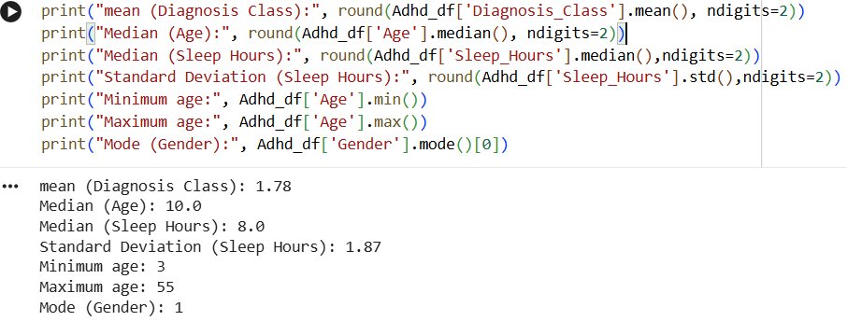
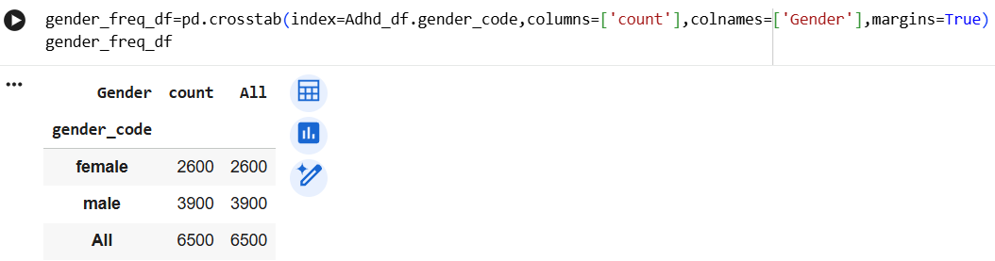
Descriptive Statistics & Frequency table

Slide 17
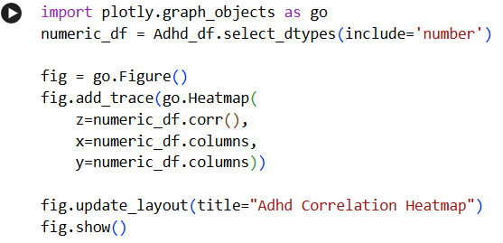
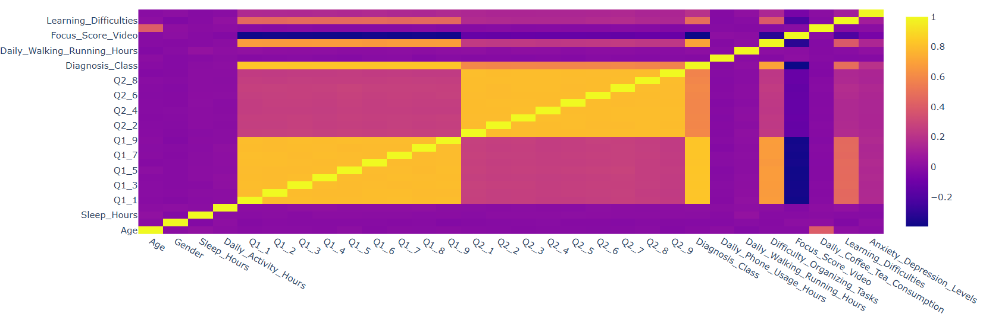
ADHD Correlation Heatmap

Slide 18
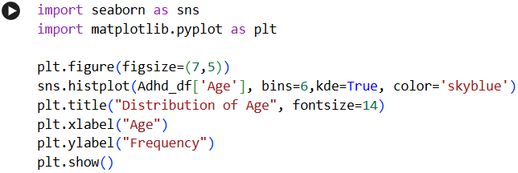
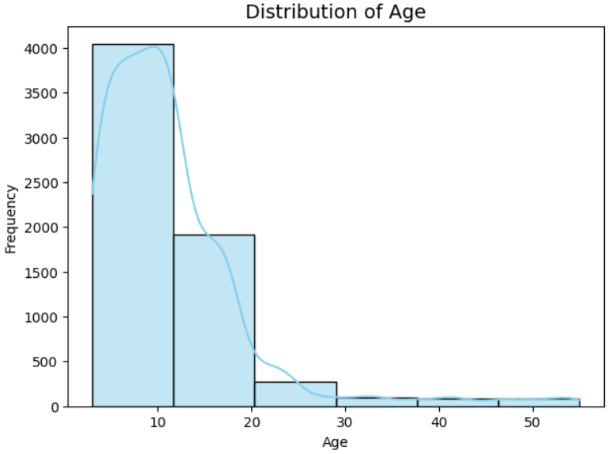
visualizations
1- What is the age distribution of the participants, and are there any noticeable concentration patterns?
- ADHD is more commonly identified in children because their social environment makes the symptoms easier to notice .
- Parents and teachers observe them daily
most research focuses on this age group .
- Adults also have ADHD, but their symptoms are often less obvious .

Slide 19
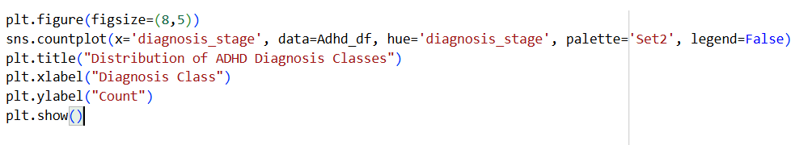
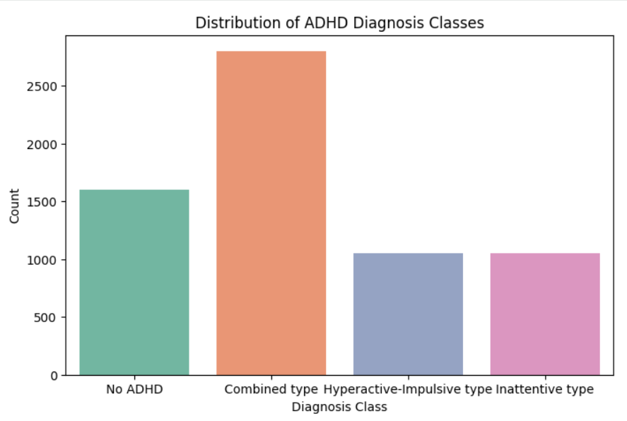
visualizations
2- What is the distribution of the different ADHD diagnosis classes within the dataset?
- The Combined Type is the most prevalent ADHD diagnosis .
- Both the Hyperactive-Impulsive & Inattentive types appear equally common .
- A substantial number of participants show no ADHD symptoms, allowing balanced comparative analysis .

Slide 20
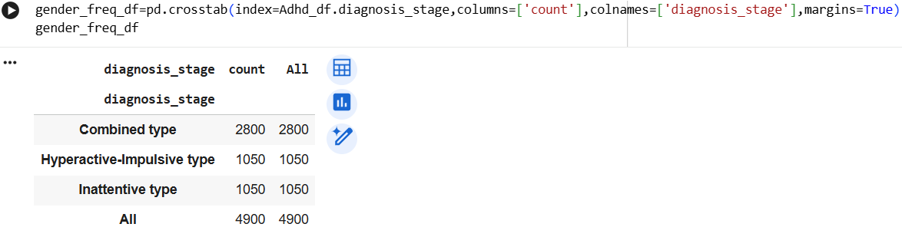
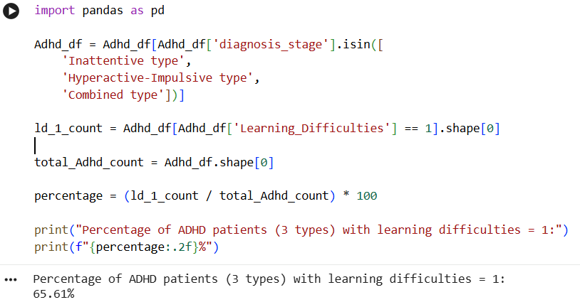
visualization
- The percentage of the 3 Classes of ADHD that have learning difficulties?
- The 65.61% rate is extremely high, indicating a strong association between ADHD and learning difficulties.
- This can be explained by attention problems, organizational challenges, and hyperactivity, all of which directly impact learning performance.

Slide 21
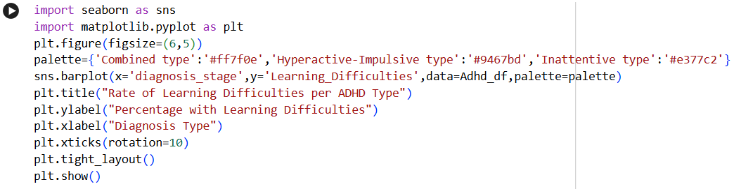
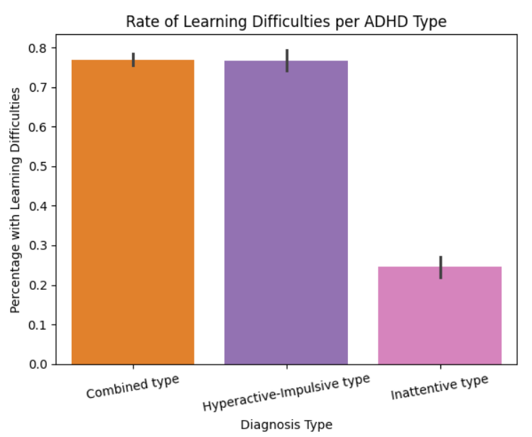
visualization
3- What is the prevalence of learning difficulties among individuals diagnosed with the three ADHD subtypes?
- Combined & Hyperactive-Impulsive types → ≈77% have learning difficulties .
- Inattentive type → ≈25% only .
- ADHD subtype strongly affects learning difficulty levels .
- Important for educators to recognize subtype differences .

Slide 22
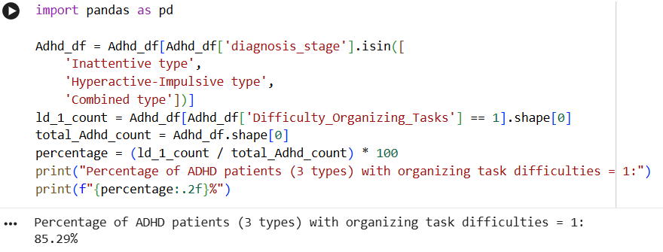
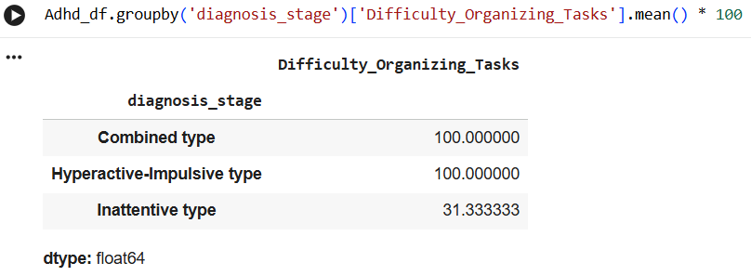
visualization
4- How do task-organization difficulties vary among the different ADHD subtypes?
- The results indicate sharp differences among the three ADHD subtypes:
Combined type — 100% have difficulty organizing tasks .
Hyperactive-Impulsive type — 100% have difficulty organizing tasks .
Inattentive type — only 31% have difficulty organizing tasks .

Slide 23
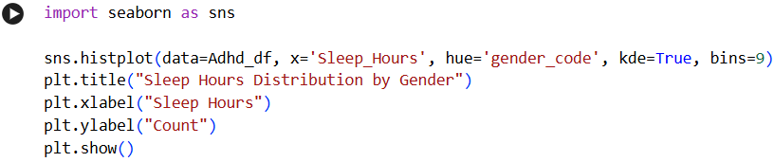
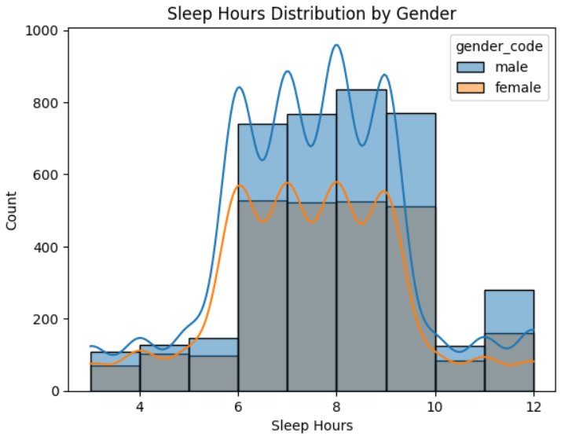
visualizations
5- How are sleep hours distributed among participants & are there differences in average sleep hours between males and females?
- Most participants sleep between 6 and 10 hours .
- Comparing sleep hours between genders revealed that males tend to sleep slightly more hours on average than females .
- This difference may suggest behavioural or lifestyle variations between the two groups .

Slide 24
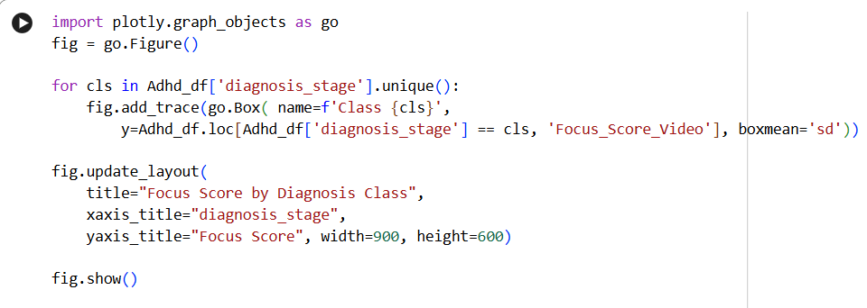
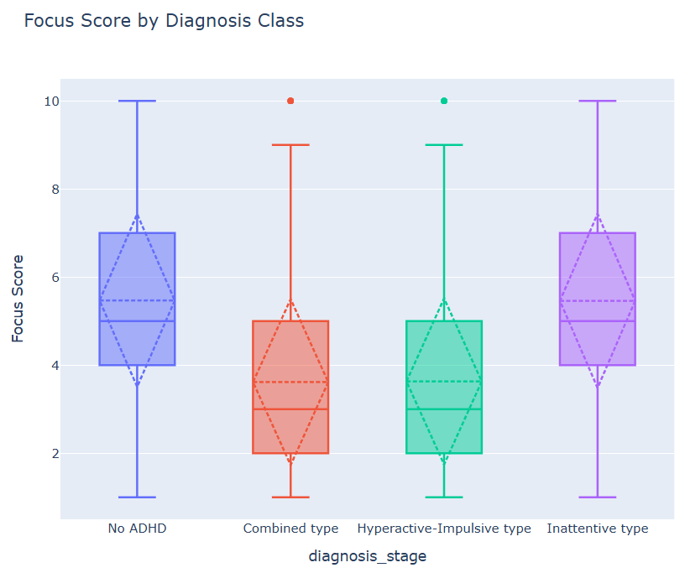
visualizations
6- Does the focus score during video-watching differ across the ADHD diagnosis classes?
-From the chart, it is clear that lower concentration levels are associated with higher diagnosis scores, which supports the hypothesis that the symptoms of ADHD negatively affect concentration .

Slide 25
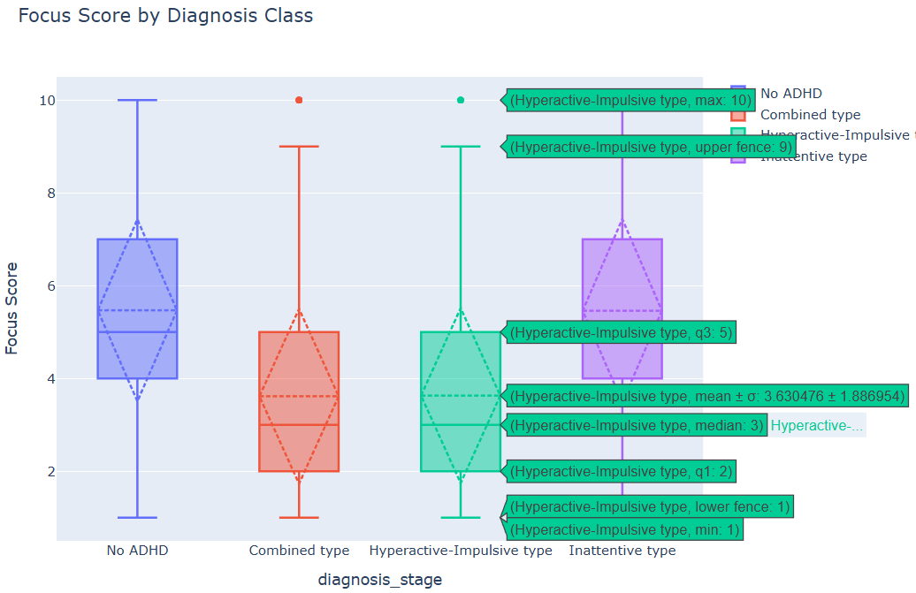
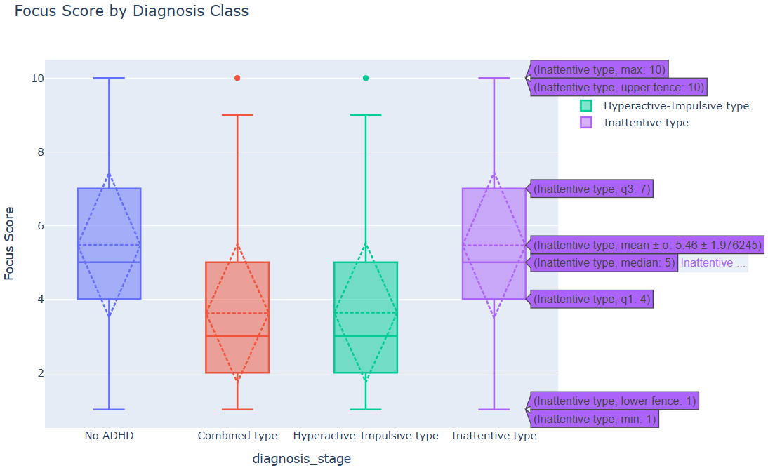
Continue
- Higher diagnosis classes show lower focus scores, indicating reduced attention and concentration level, and vice versa .

Slide 26
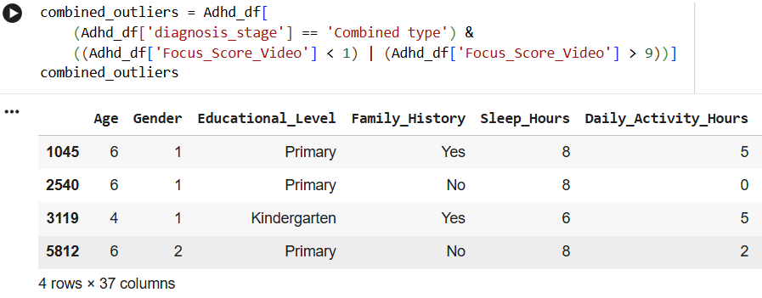
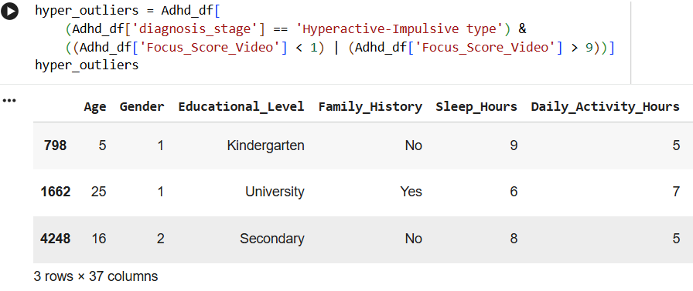
Check The Outliers

Slide 27
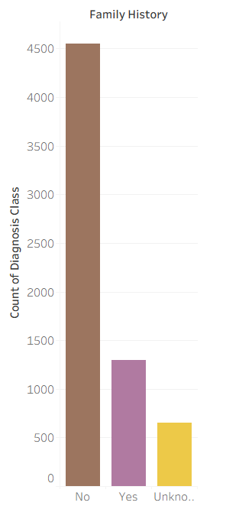
visualizations
7- Does having a family history of ADHD influence the diagnosis class of the individual?
- Most participants reported no family history .
- Participants who do have a family history of ADHD represent a smaller portion .
- A very small group reported unknown status .
- Environmental or behavioral factors could play an important role alongside genetic factors .

Slide 28
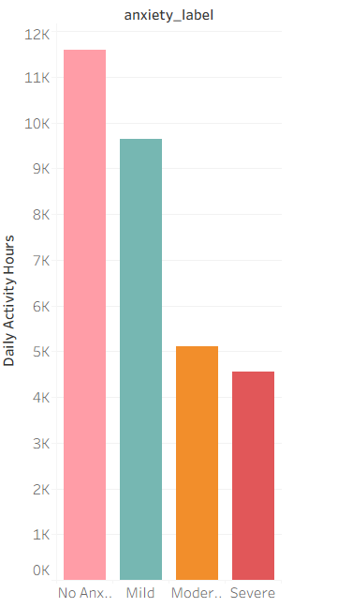
visualization
8- How does daily activity level vary across different anxiety severity categories?"
- No Anxiety: Highest activity.
- Mild Anxiety: Slightly lower activity.
- Moderate Anxiety: Sharp drop .
- Severe Anxiety: Lowest activity.
- The trend suggests a strong negative association between anxiety severity and daily activity levels

Slide 29
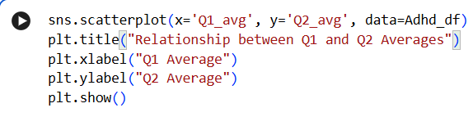
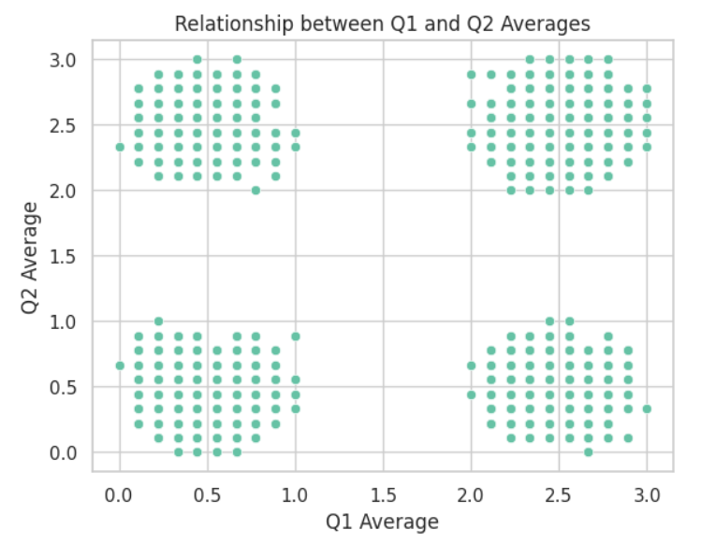
9- Is there agreement between the self-assessment (Q1) and the observer assessment (Q2), or are there noticeable differences?
visualizations
-The plot shows moderate agreement between self-reported and observer-reported ADHD symptoms .
-The four clusters highlight meaningful differences in perception .
-Indicating that self-awareness does not always align perfectly with external observation .

Slide 30
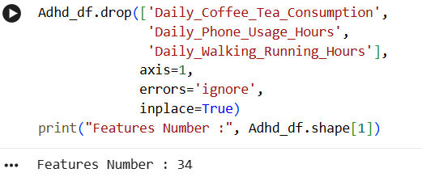
Dropping

Slide 31
Main Findings
Age: Most participants are students between 3-18 .
ADHD Types: The Combined Type is the most prevalent among participants .
Learning Difficulties: Highest rates appeared in the Combined and Hyperactive-Impulsive types (≈77%) .
Task-Organization Difficulties: Reached 100% in the same two types, indicating significant executive function challenges .
Gender & Sleep: Minor differences between males and females, but the overall pattern is similar .
Focus Score: Clear differences in video-watching focus across diagnosis types .
Family History: Having a family history increases the likelihood of an ADHD diagnosis .
Anxiety & Activity: Higher anxiety is associated with lower daily activity .
Self vs. Observer Ratings: Only moderate agreement, highlighting the need for multiple assessment sources .

Slide 32
What Did You Learn?
Each subtype has its own pattern of behaviors and difficulties.
Anxiety strongly affects daily activity levels.
Learning difficulties and task-organization challenges vary significantly across subtypes.

Slide 33
What Surprised You?
The very strong relationship between anxiety and reduced activity.
The 100% prevalence of organization difficulties in two ADHD subtypes.
The inattentive type showing fewer learning difficulties compared to other types.
Presence of unrealistic values (e.g., activity = 0) requiring cleaning.

Slide 34
Did The Data Support Your Hypotheses?
Yes, most of the expectations were correct.
As the severity of ADHD symptoms increased, the difficulty in task organization also increased.
Anxiety was associated with decreased activity levels.
A positive family history increased the likelihood of diagnosis.

Slide 35
Future Work
Investigating why the inattentive type shows lower learning difficulties.
Analyzing the relationship between anxiety, and ADHD types more deeply.
Adding performance-based behavioral data.
Conducting longitudinal analyses to track symptom development.

Slide 36

Tools Used
Excel
Python
Tableau
Powerpoint
Word

